Slide 1


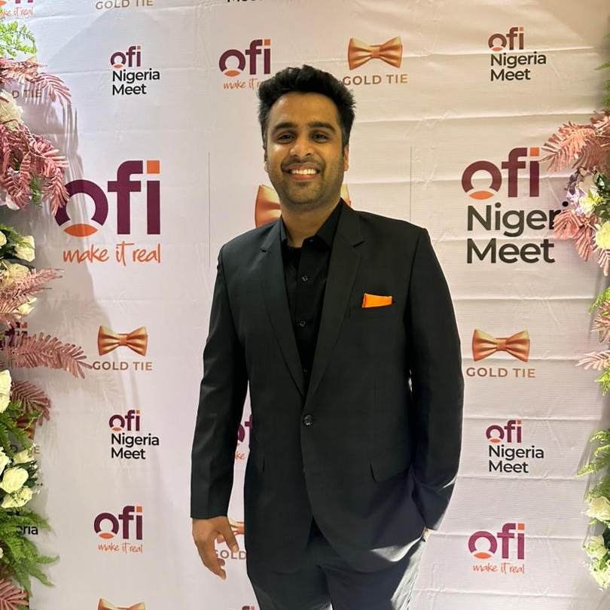
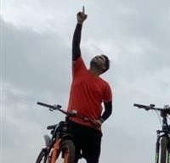
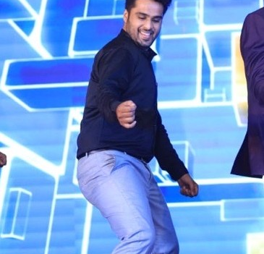
Getting to Know Me
Work
Personal
My role
Branch Manager
Significant others / family members / furry friends in my life
A fiancé / Parents and a kid Sister
Tenure in ofi/Olam
2 Years and 5 months
How I enjoy spending my free time
Gaming, Music and light reading
Previous companies I have worked at
TCS, Valency
My favorite / comfort food
Indian Chinese
Why I joined ofi/Olam and what keeps me here?
Olam/ofi Culture and learning opportunity
My favorite song
I was made for Lovin’ you – by KISS
Deepak Goyal
Call me ‘Deepak’
A fun fact about me
When music turns up, I let loose and bust a dance move or two.
This is me outside work, doing stuff I enjoy in my life …

